Slide 1
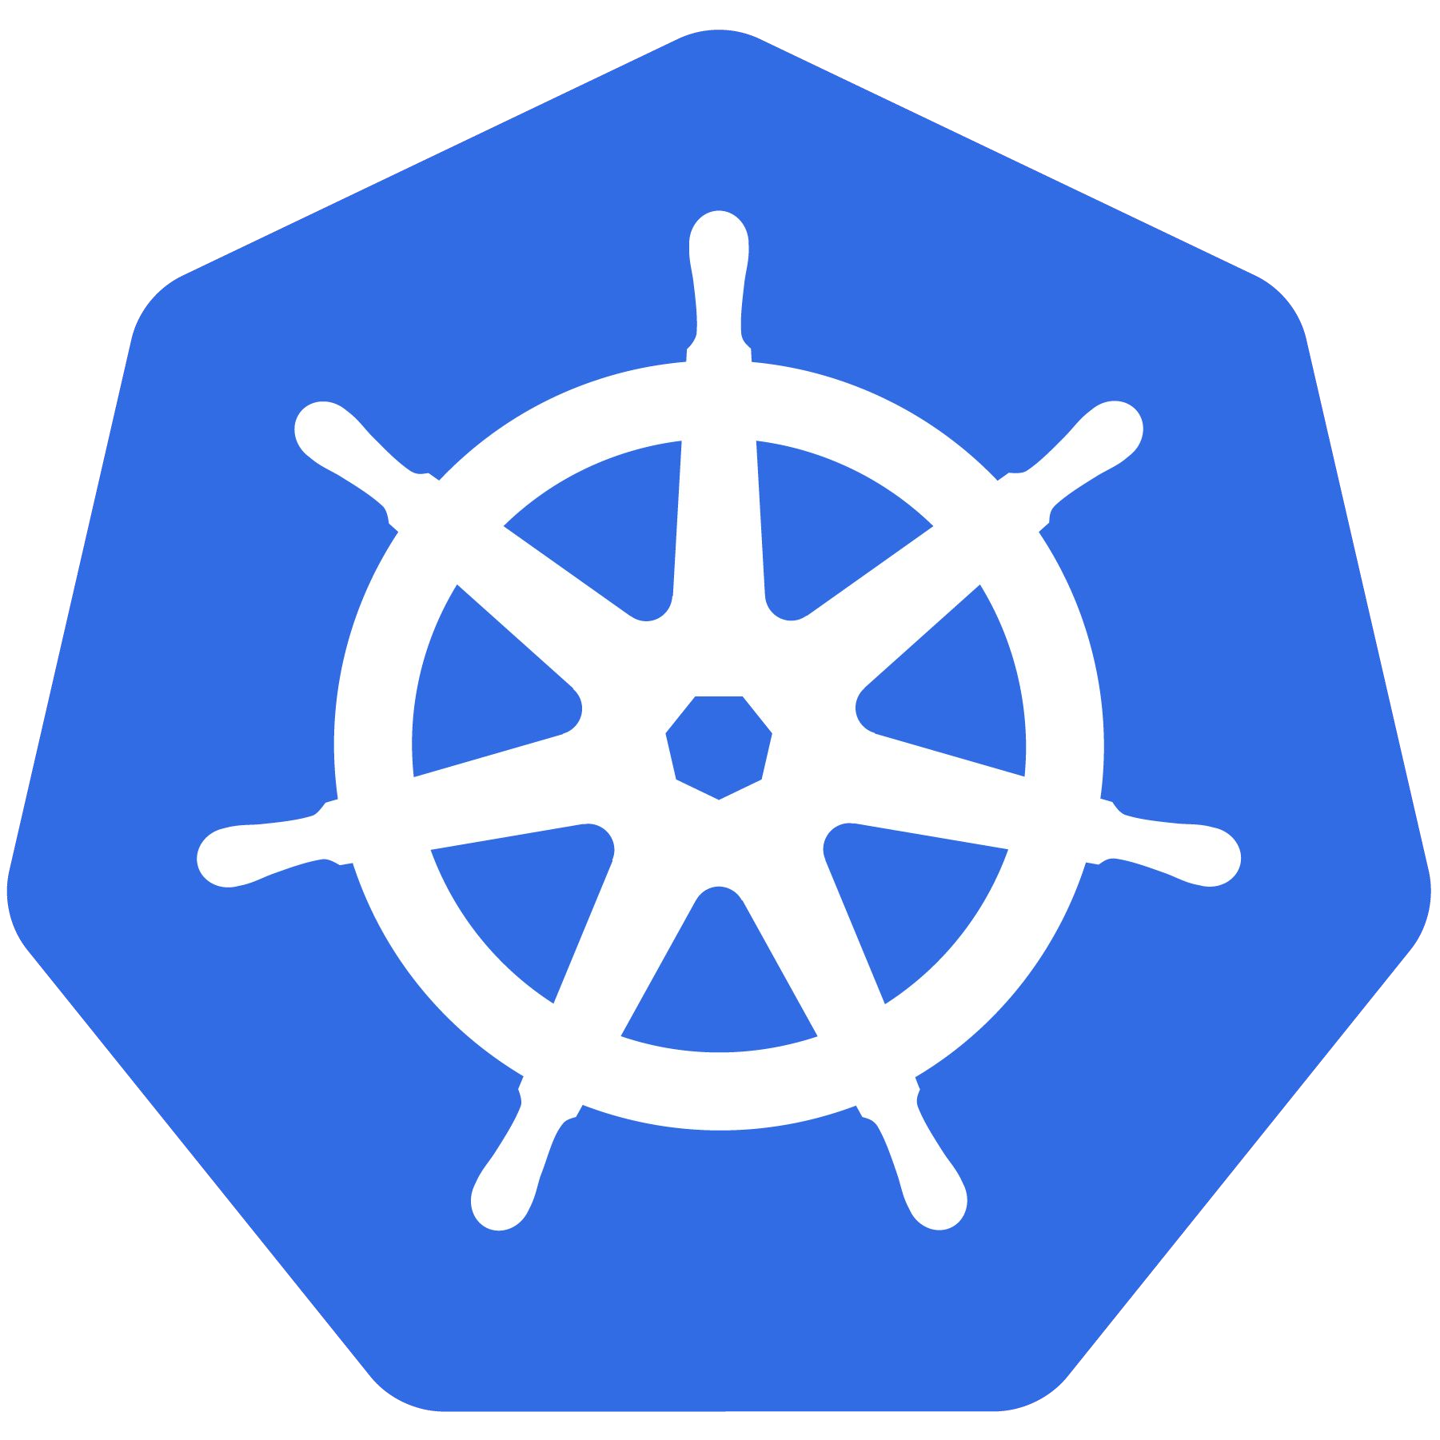
Kubernetes
An Introduction

Slide 2
Credits and thanks to …
Bob Killen
Senior Research Cloud Administrator
Jeffrey Sica
Senior Research Database Administrator

Slide 3
Project Overview

Slide 4
What is Kubernetes?
Project that was spun out of Google as an open source container orchestration platform.
Built from the lessons learned in the experiences of developing and running Google’s Borg and Omega.
Designed from the ground-up as a loosely coupled collection of components centered around deploying, maintaining and scaling workloads.

Slide 5
Architecture Overview

Slide 6
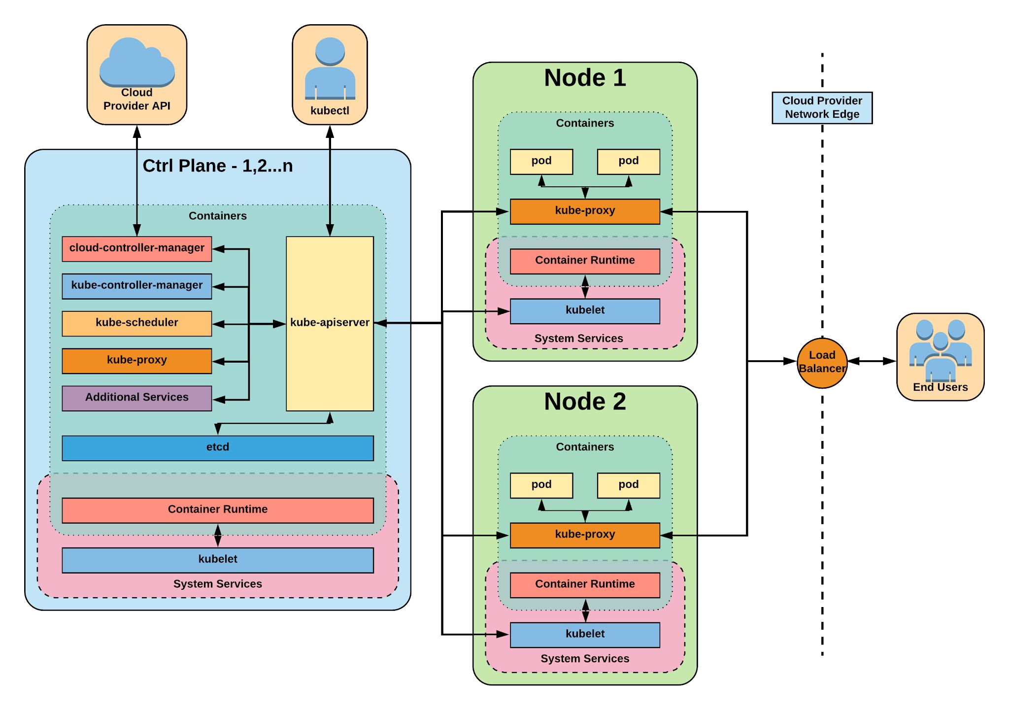


Slide 7

Control Plane Components
Architecture Overview

Slide 8
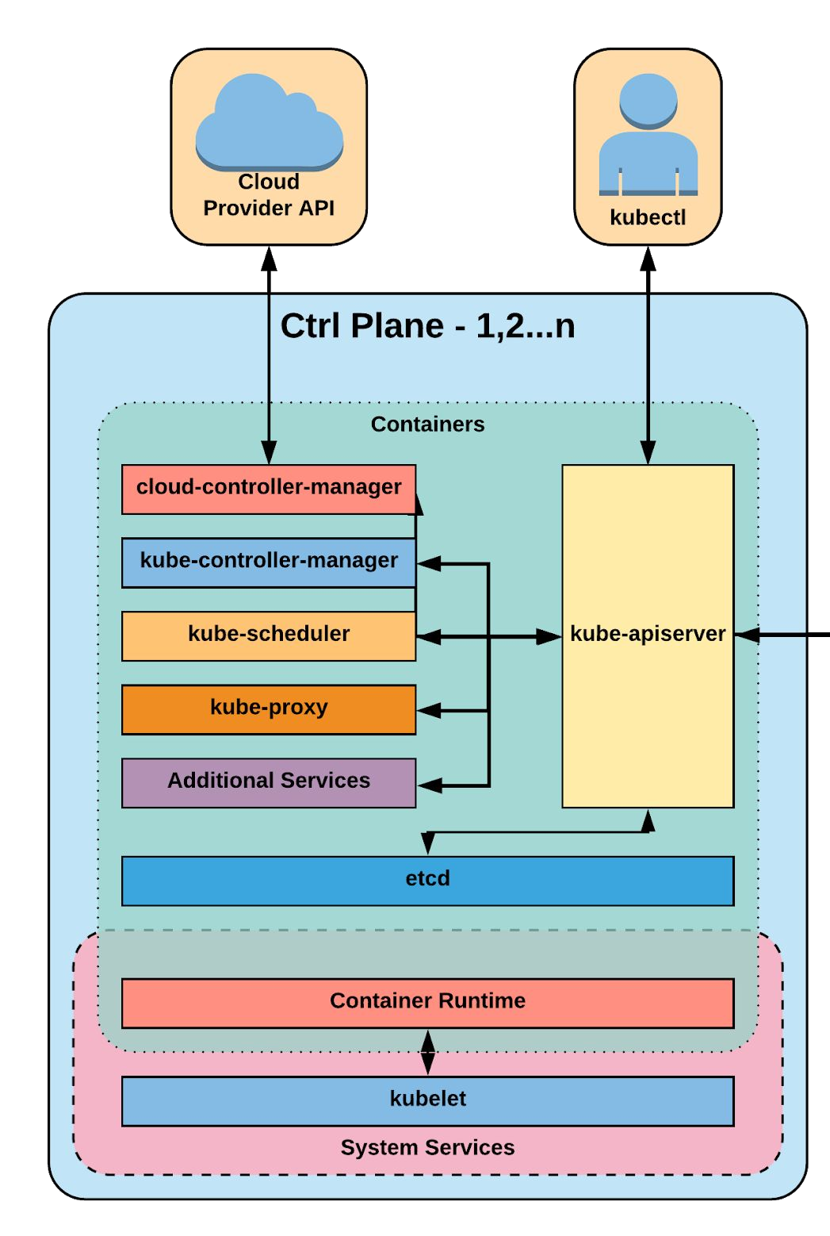
Control Plane Components
kube-apiserver
etcd
kube-controller-manager
kube-scheduler

Slide 9
Node Components
Architecture Overview

Slide 10
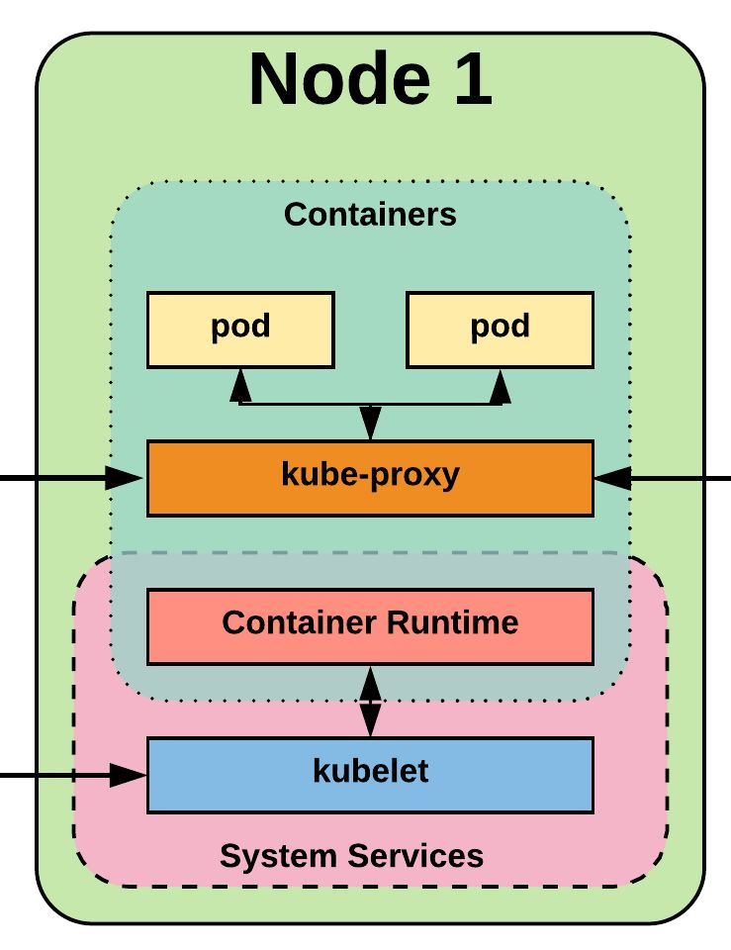
Node Components
kubelet
kube-proxy
Container Runtime Engine

Slide 11
API Versioning
Three tiers of API maturity levels.
Also referenced within the object apiVersion.
Format:
/apis/<group>/<version>/<resource>
Examples:
/apis/apps/v1/deployments
/apis/batch/v1beta1/cronjobs
Alpha: Possibly buggy, And may change. Disabled by default.
Beta: Tested and considered stable. However API Schema may change. Enabled by default.
Stable: Released, stable and API schema will not change.
Enabled by default.

Slide 12
Object Model
Objects are a “record of intent” or a persistent entity that represent the desired state of the object within the cluster.
All objects MUST have apiVersion, kind, and poses the nested fields metadata.name, metadata.namespace, and metadata.uid.

Slide 13
Object Expression - YAML
apiVersion: v1 kind: Pod
metadata: name: yaml
spec: containers: name: container1 image: nginx name: container2 image: alpine
Scalar
Mapping Hash Dictionary
Sequence Array List

Slide 14
Object Model - Workloads
Workload related objects within Kubernetes have an additional two nested fields spec and status.
spec - Describes the desired state or
configuration of the object to be created.
status - Is managed by Kubernetes and describes the actual state of the object and its history.

Slide 15
Workload Object Example
Example Object
apiVersion: v1 kind: Pod metadata:
name: pod-example spec:
containers:
- name: nginx
image: nginx:stable-alpine ports:
- containerPort: 80
Example Status Snippet
status: conditions:
lastProbeTime: null
lastTransitionTime: 2018-02-14T14:15:52Z status: "True"
type: Ready
lastProbeTime: null
lastTransitionTime: 2018-02-14T14:15:49Z status: "True"
type: Initialized
lastProbeTime: null
lastTransitionTime: 2018-02-14T14:15:49Z status: "True"
type: PodScheduled

Slide 16
Lab - github.com/mrbobbytables/k8s-intro-tutorials/blob/master/cli
Using the API
(aka, using the CLI)

Slide 17
Namespaces
Pods
Labels
Selectors
Services
Core Objects
Concepts and Resources

Slide 18
Core Concepts
Kubernetes has several core building blocks that make up the foundation of their higher level components.
Namespaces
Pods Labels
Services Selectors

Slide 19
Namespaces
Namespaces are a logical cluster or environment, and are the primary method of partitioning a cluster or scoping access.
apiVersion: v1 kind: Namespace metadata:
name: prod labels:
app: MyBigWebApp
$ kubectl get ns --show-labels NAME STATUS AGE
default Active 11h
kube-public Active 11h kube-system Active 11h prod Active 6s
LABELS
<none>
<none>
<none> app=MyBigWebApp

Slide 20
Default Namespaces
default: The default namespace for any object without a namespace.
kube-system: Acts as
the home for objects and resources created by Kubernetes itself.
kube-public: A special namespace; readable by all users that is reserved for cluster bootstrapping and configuration.
$ kubectl get ns --show-labels NAME STATUS AGE |  |  | LABELS
default | Active | 11h | <none>
kube-public | Active | 11h | <none>
kube-system | Active | 11h | <none>

Slide 21
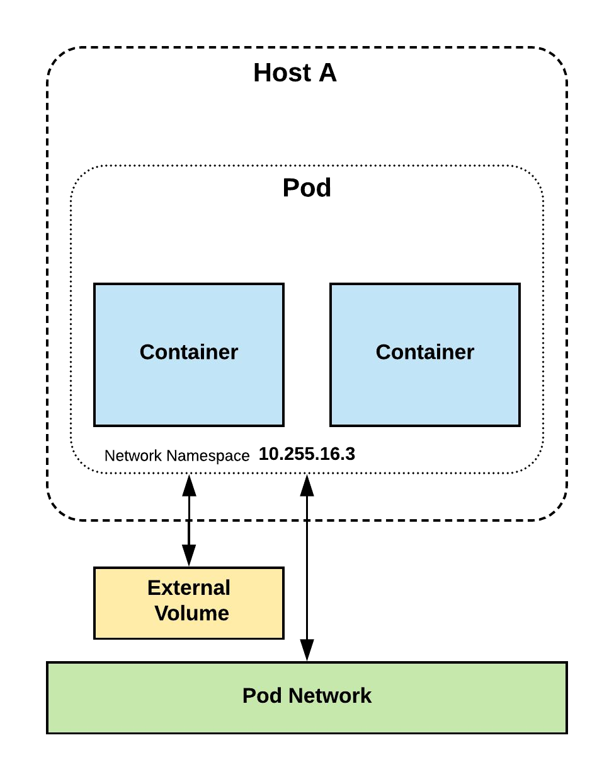
Pod
Atomic unit or smallest “unit of work”of Kubernetes.
Foundational building block of Kubernetes Workloads.
Pods are one or more containers that share volumes, a network namespace, and are a part of a single context.

Slide 22
Pod Examples
apiVersion: v1 kind: Pod metadata:
name: pod-example spec:
containers:
- name: nginx
image: nginx:stable-alpine ports:
- containerPort: 80
apiVersion: v1 kind: Pod metadata:
name: multi-container-example spec:
containers:
name: nginx
image: nginx:stable-alpine volumeMounts:
name: html
mountPath: /usr/share/nginx/html
name: content
image: alpine:latest command: ["/bin/sh", "-c"] args:
- while true; do
date >> /html/index.html; sleep 5;
done volumeMounts:
name: html mountPath: /html
volumes:
name: html emptyDir: {}

Slide 23
Key Pod Container Attributes
name - The name of the container
image - The container image
ports - array of ports to expose. Can be granted a friendly name and protocol may be specified
env - array of environment variables
command - Entrypoint array (equiv to Docker ENTRYPOINT)
args - Arguments to pass to the command (equiv to Docker CMD)
Container
name: nginx
image: nginx:stable-alpine ports:
containerPort: 80 name: http protocol: TCP
env:
name: MYVAR value: isAwesome
command: [“/bin/sh”, “-c”]
args: [“echo ${MYVAR}”]

Slide 24
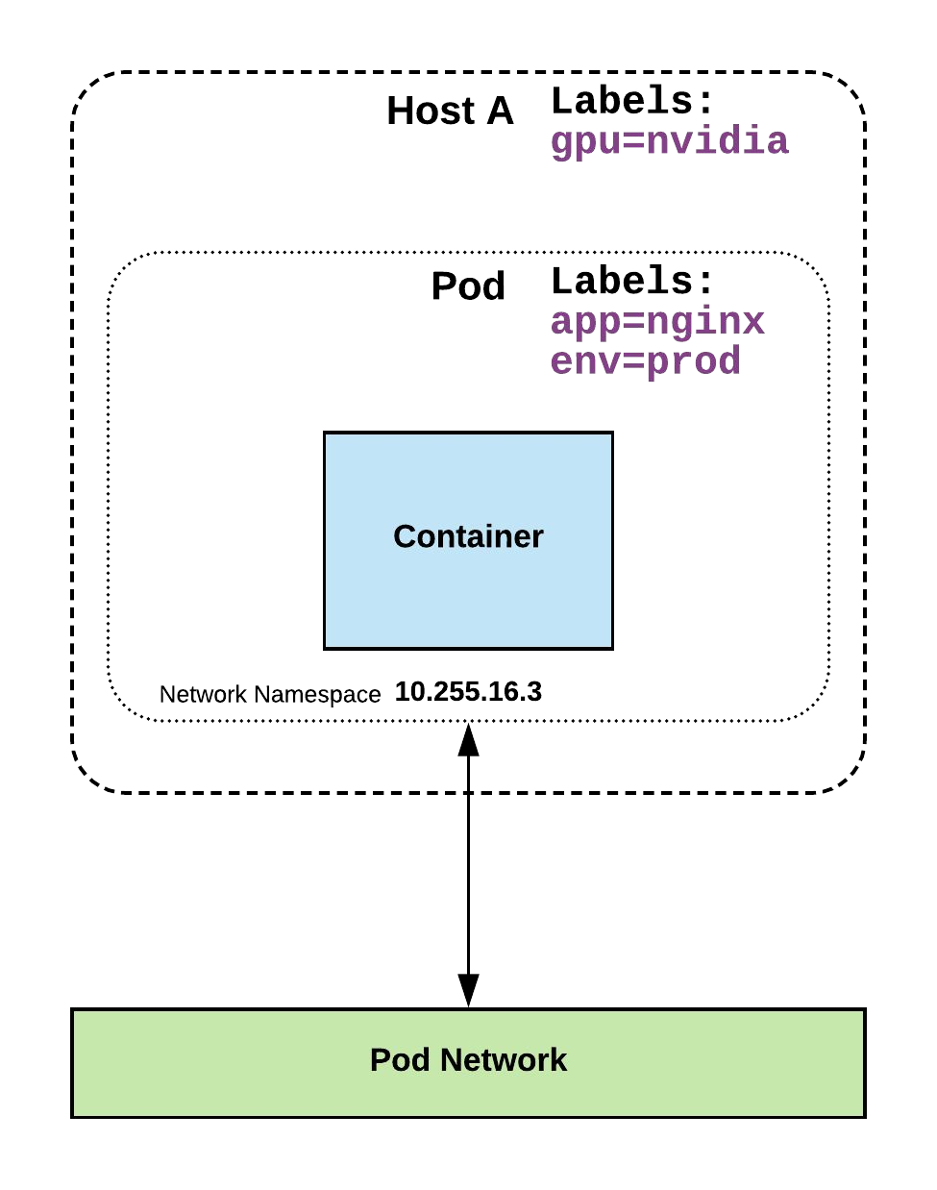
Labels
key-value pairs that are used to identify, describe and group together related sets of objects or resources.
NOT characteristic of uniqueness.
Have a strict syntax with a slightly limited character set*.
* https://kubernetes.io/docs/concepts/overview/working-with-objects/labels/#syntax-and-character-set

Slide 25
Label Example
apiVersion: v1 kind: Pod metadata:
name: pod-label-example labels:
app: nginx env: prod
spec:
containers:
- name: nginx
image: nginx:stable-alpine ports:
- containerPort: 80

Slide 26
Selectors
Selectors use labels to filter or select objects, and are used throughout Kubernetes.
apiVersion: v1 kind: Pod metadata:
name: pod-label-example labels:
app: nginx env: prod
spec:
containers:
- name: nginx
image: nginx:stable-alpine ports:
- containerPort: 80 nodeSelector:
gpu: nvidia

Slide 27
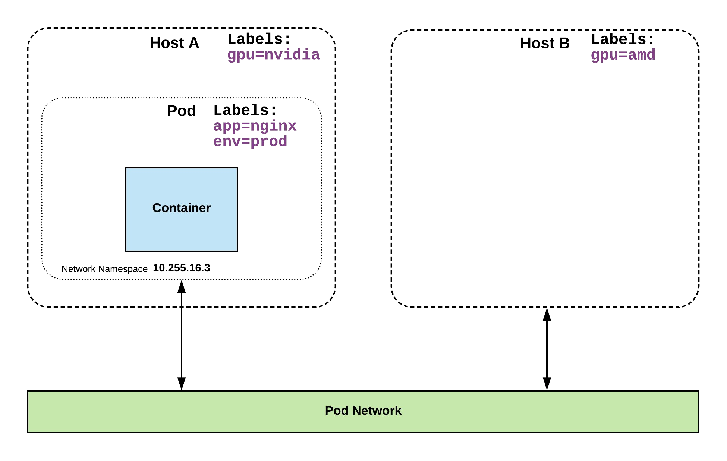
Selector Example
apiVersion: v1 kind: Pod metadata:
name: pod-label-example labels:
app: nginx env: prod
spec:
containers:
- name: nginx
image: nginx:stable-alpine ports:
- containerPort: 80 nodeSelector:
gpu: nvidia

Slide 28
Selector Types
Equality based selectors allow for simple filtering (=,==, or !=).
Set-based selectors are supported on a limited subset of objects.
However, they provide a method of filtering on a set of values, and supports multiple operators including: in, notin, and exist.
selector: matchLabels:
gpu: nvidia
selector: matchExpressions:
- key: gpu operator: in
values: [“nvidia”]

Slide 29
Services
Unified method of accessing the exposed workloads of Pods.
Durable resource (unlike Pods)
static cluster-unique IP
static namespaced DNS name
<service name>.<namespace>.svc.cluster.local

Slide 30
Services
Target Pods using equality based selectors.
Uses kube-proxy to provide simple load-balancing.
kube-proxy acts as a daemon that creates local entries in the host’s iptables for every service.

Slide 31
Service Types
There are 4 major service types:
ClusterIP (default)
NodePort
LoadBalancer
ExternalName

Slide 32
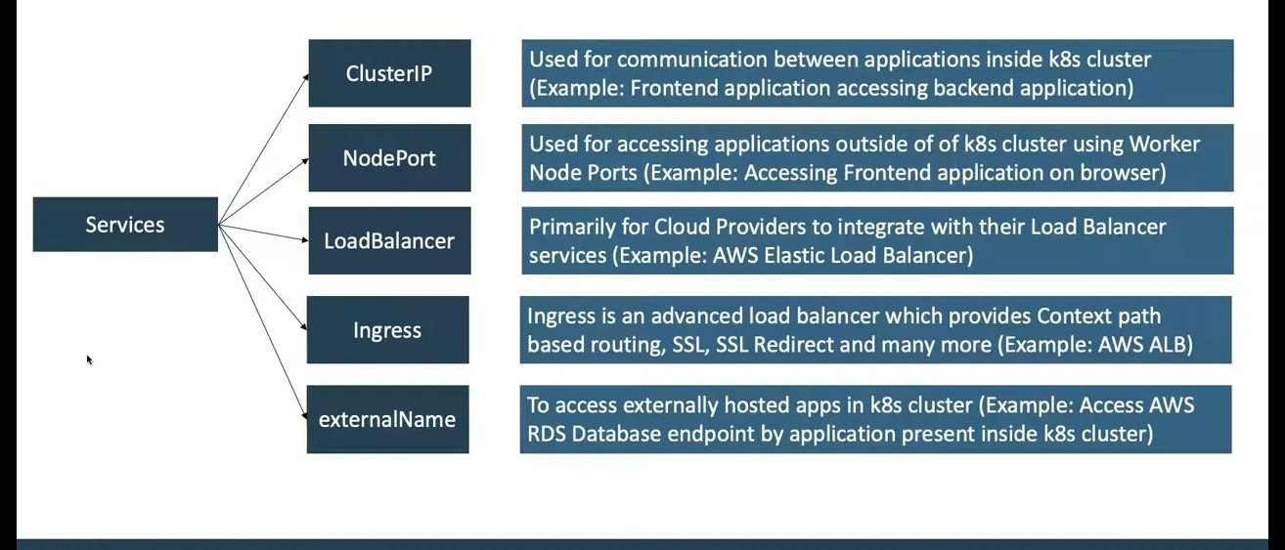

Slide 33
ClusterIP Service
apiVersion: v1 kind: Service metadata:
name: example-prod spec:
selector: app: nginx env: prod
ports:
- protocol: TCP port: 80
targetPort: 80
ClusterIP services exposes a service on a strictly cluster internal virtual IP.

Slide 34
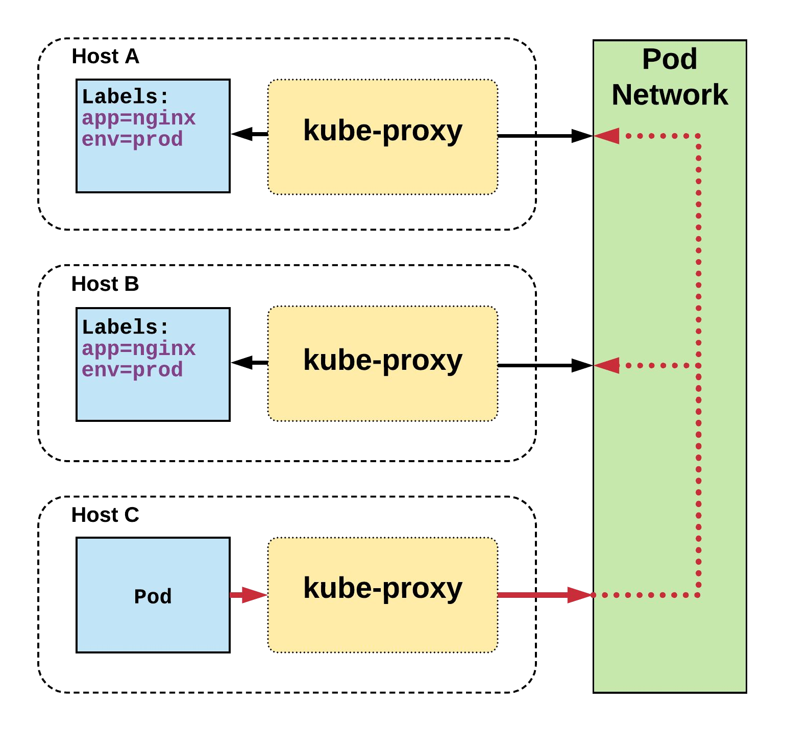
Cluster IP Service
Name: Selector: Type:
IP:
Port: TargetPort: Endpoints:
example-prod app=nginx,env=prod ClusterIP 10.96.28.176
<unset> 80/TCP 80/TCP
10.255.16.3:80,
10.255.16.4:80
/ # nslookup example-prod.default.svc.cluster.local
Name: example-prod.default.svc.cluster.local
Address 1: 10.96.28.176 example-prod.default.svc.cluster.local

Slide 35
NodePort Service
apiVersion: v1 kind: Service metadata:
name: example-prod spec:
type: NodePort selector:
app: nginx env: prod
ports:
- nodePort: 32410 protocol: TCP port: 80
targetPort: 80
NodePort services extend the
ClusterIP service.
Exposes a port on every node’s IP.
Port can either be statically defined, or dynamically taken from a range between
30000-32767.

Slide 36
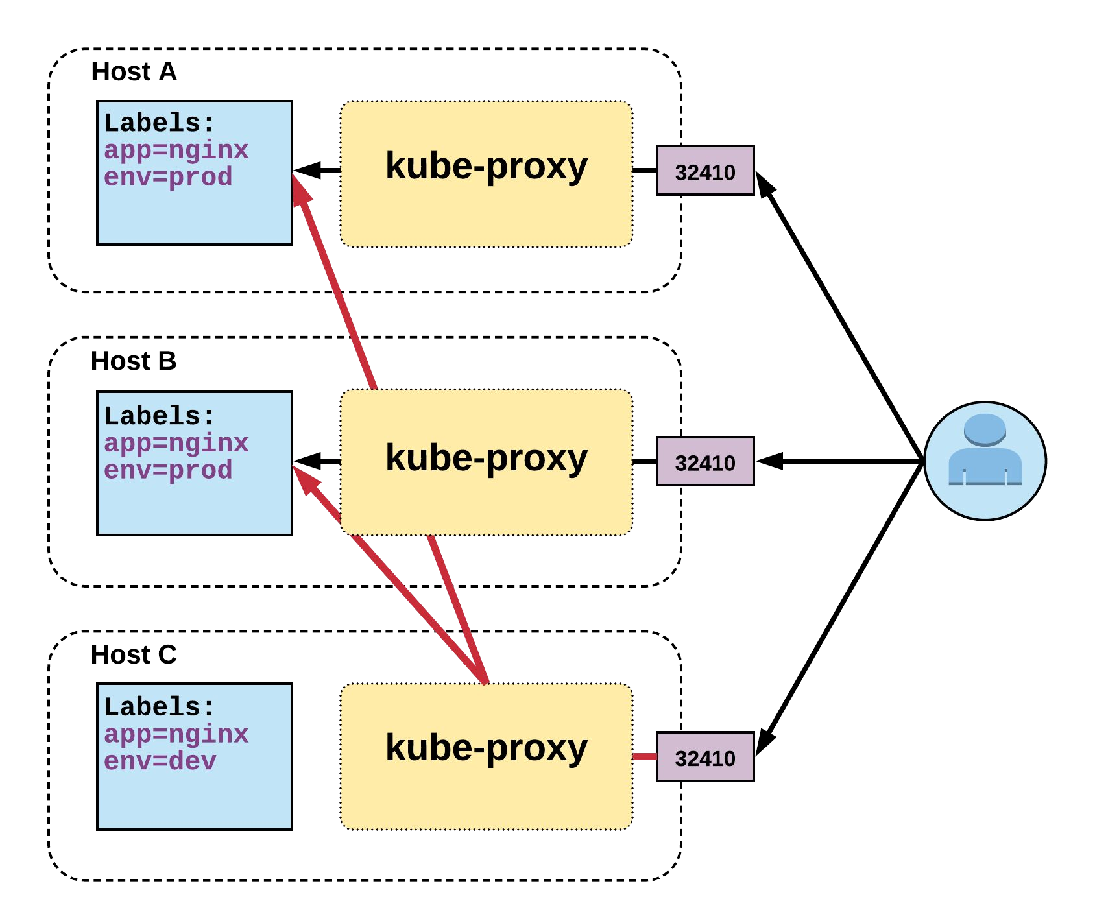
NodePort Service
Name: Selector: Type:
IP:
Port: TargetPort: NodePort: Endpoints:
example-prod app=nginx,env=prod NodePort 10.96.28.176
<unset> 80/TCP
80/TCP
<unset> 32410/TCP
10.255.16.3:80,
10.255.16.4:80

Slide 37
LoadBalancer Service
apiVersion: v1 kind: Service metadata:
name: example-prod spec:
type: LoadBalancer selector:
app: nginx env: prod
ports:
protocol: TCP port: 80
targetPort: 80
LoadBalancer services extend NodePort.
Works in conjunction with an external system to map a cluster external IP to the exposed service.

Slide 38
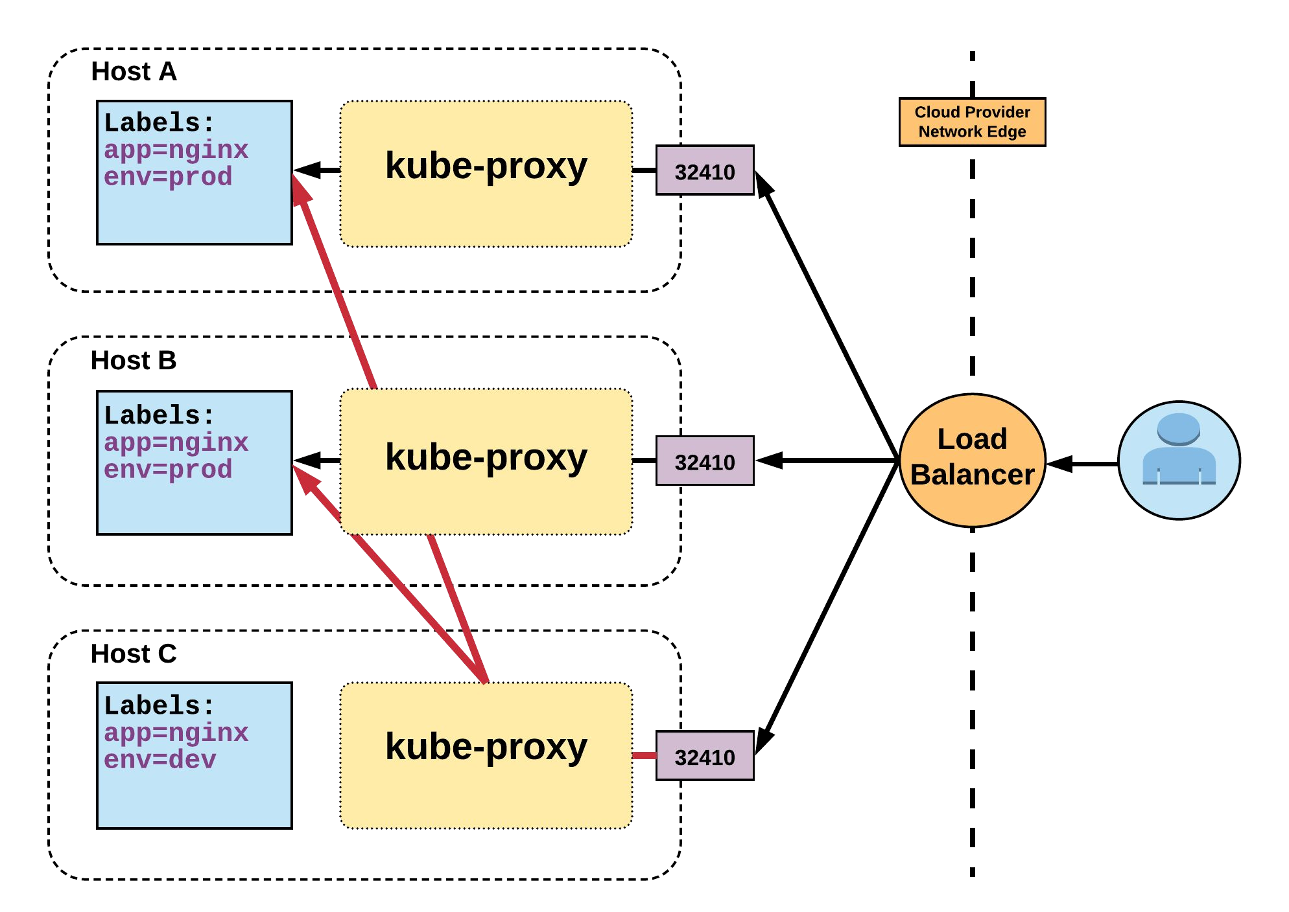
LoadBalancer Service
Name: Selector: Type:
IP:
LoadBalancer Ingress: Port: TargetPort: NodePort: Endpoints:
example-prod app=nginx,env=prod LoadBalancer 10.96.28.176
172.17.18.43
<unset> 80/TCP 80/TCP
<unset> 32410/TCP 10.255.16.3:80,
10.255.16.4:80

Slide 39
ExternalName Service
apiVersion: v1 kind: Service metadata:
name: example-prod spec:
type: ExternalName spec:
externalName: example.com
ExternalName is used to reference endpoints OUTSIDE the cluster.
Creates an internal CNAME DNS entry that aliases another.

Slide 40
Workloads
Workloads within Kubernetes are higher level objects that manage Pods or other higher level objects.
In ALL CASES a Pod Template is included, and acts the base tier of management.

Slide 41
Pod Template
Workload Controllers manage instances of Pods based off a provided template.
Pod Templates are Pod specs with limited metadata.
Controllers use Pod Templates to make actual pods.
apiVersion: v1 kind: Pod metadata:
name: pod-example labels:
app: nginx spec:
containers:
- name: nginx image: nginx
template: metadata:
labels: app: nginx
spec:
containers:
- name: nginx image: nginx

Slide 42
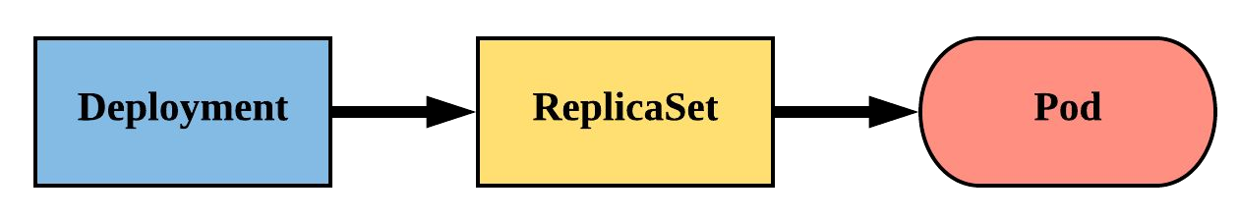
Deployment
Declarative method of managing Pods via ReplicaSets.
Provide rollback functionality and update control.
Updates are managed through the pod-template-hash
label.
Each iteration creates a unique label that is assigned to both the ReplicaSet and subsequent Pods.

Slide 43
Deployment
revisionHistoryLimit: The number of previous iterations of the Deployment to retain.
strategy: Describes the method of updating the Pods based on the type. Valid options are RollingUpdate or Recreate.
RollingUpdate: Cycles through updating the Pods according to the parameters: maxSurge and maxUnavailable.
Recreate: All existing Pods are killed before the new ones are created.
apiVersion: apps/v1 kind: Deployment metadata:
name: deploy-example
spec:
replicas: 3
revisionHistoryLimit: 3 selector:
matchLabels:
app: nginx env: prod
strategy:
type: RollingUpdate rollingUpdate:
maxSurge: 1
maxUnavailable: 0 template:
<pod template>

Slide 44
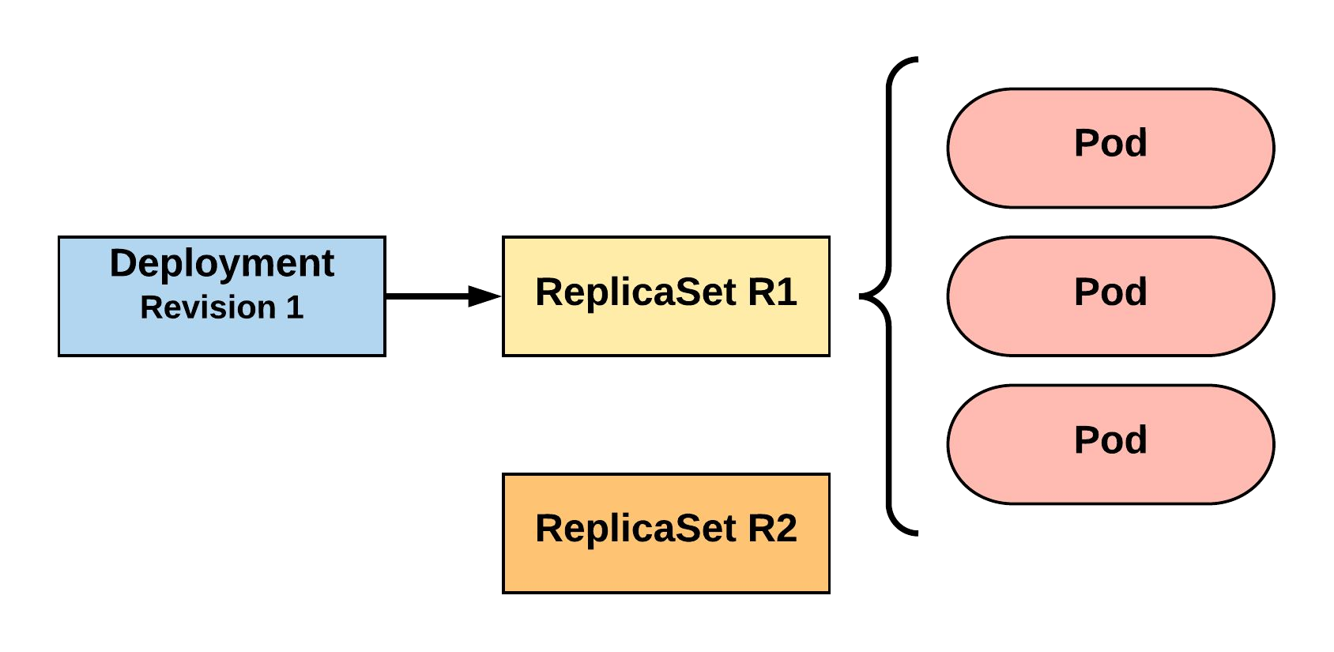
RollingUpdate Deployment
Updating pod template generates a new ReplicaSet revision.
R1 pod-template-hash: 676677fff
R2 pod-template-hash: 54f7ff7d6d
$ kubectl get replicaset NAME DESIRED | CURRENT | READY | AGE
mydep-6766777fff 3 | 3 | 3 | 5h
$ kubectl get pods NAME READY | STATUS | RESTARTS | AGE
mydep-6766777fff-9r2zn 1/1 | Running | 0 | 5h
mydep-6766777fff-hsfz9 1/1 | Running | 0 | 5h
mydep-6766777fff-sjxhf 1/1 | Running | 0 | 5h

Slide 45
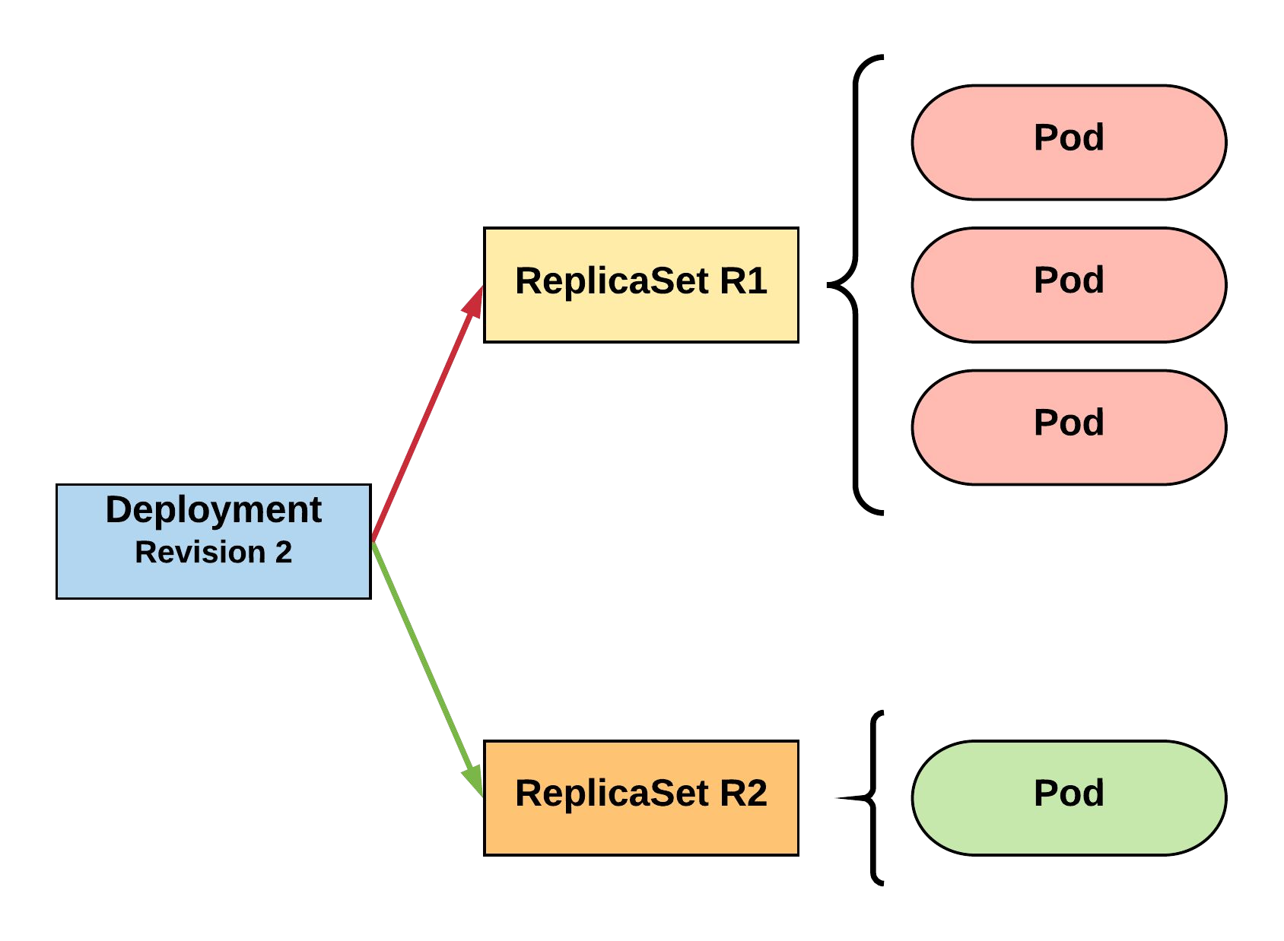
RollingUpdate Deployment
New ReplicaSet is initially scaled up based on maxSurge.
R1 pod-template-hash: 676677fff
R2 pod-template-hash: 54f7ff7d6d
$ kubectl get replicaset NAME DESIRED | CURRENT | READY | AGE
mydep-54f7ff7d6d 1 | 1 | 1 | 5s
mydep-6766777fff 2 | 3 | 3 | 5h
$ kubectl get pods NAME READY | STATUS | RESTARTS | AGE
mydep-54f7ff7d6d-9gvll 1/1 | Running | 0 | 2s
mydep-6766777fff-9r2zn 1/1 | Running | 0 | 5h
mydep-6766777fff-hsfz9 1/1 | Running | 0 | 5h
mydep-6766777fff-sjxhf 1/1 | Running | 0 | 5h

Slide 46
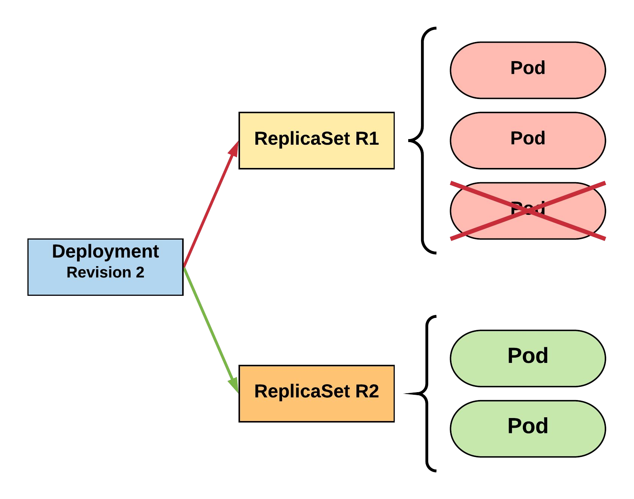
RollingUpdate Deployment
Phase out of old Pods managed by
maxSurge and maxUnavailable.
R1 pod-template-hash: 676677fff
R2 pod-template-hash: 54f7ff7d6d
$ kubectl get replicaset NAME DESIRED | CURRENT | READY | AGE
mydep-54f7ff7d6d 2 | 2 | 2 | 8s
mydep-6766777fff 2 | 2 | 2 | 5h
$ kubectl get pods NAME READY | STATUS | RESTARTS | AGE
mydep-54f7ff7d6d-9gvll 1/1 | Running | 0 | 5s
mydep-54f7ff7d6d-cqvlq 1/1 | Running | 0 | 2s
mydep-6766777fff-9r2zn 1/1 | Running | 0 | 5h
mydep-6766777fff-hsfz9 1/1 | Running | 0 | 5h

Slide 47
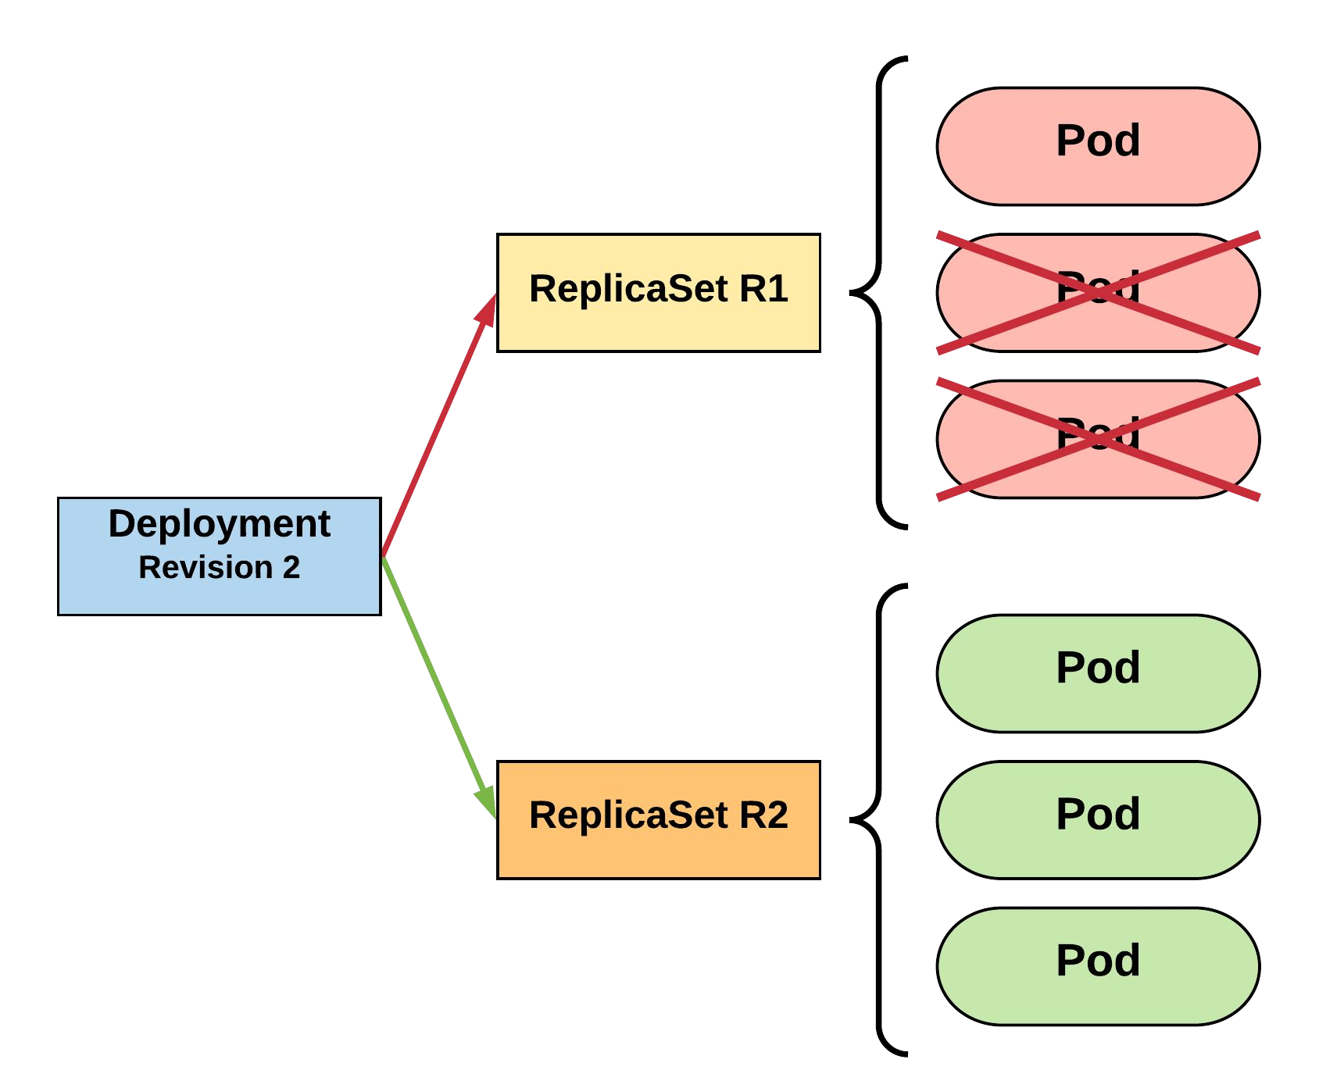
RollingUpdate Deployment
Phase out of old Pods managed by
maxSurge and maxUnavailable.
R1 pod-template-hash: 676677fff
R2 pod-template-hash: 54f7ff7d6d
$ kubectl get replicaset NAME DESIRED | CURRENT | READY | AGE
mydep-54f7ff7d6d 3 | 3 | 3 | 10s
mydep-6766777fff 0 | 1 | 1 | 5h
$ kubectl get pods NAME READY | STATUS | RESTARTS | AGE
mydep-54f7ff7d6d-9gvll 1/1 | Running | 0 | 7s
mydep-54f7ff7d6d-cqvlq 1/1 | Running | 0 | 5s
mydep-54f7ff7d6d-gccr6 1/1 | Running | 0 | 2s
mydep-6766777fff-9r2zn 1/1 | Running | 0 | 5h

Slide 48
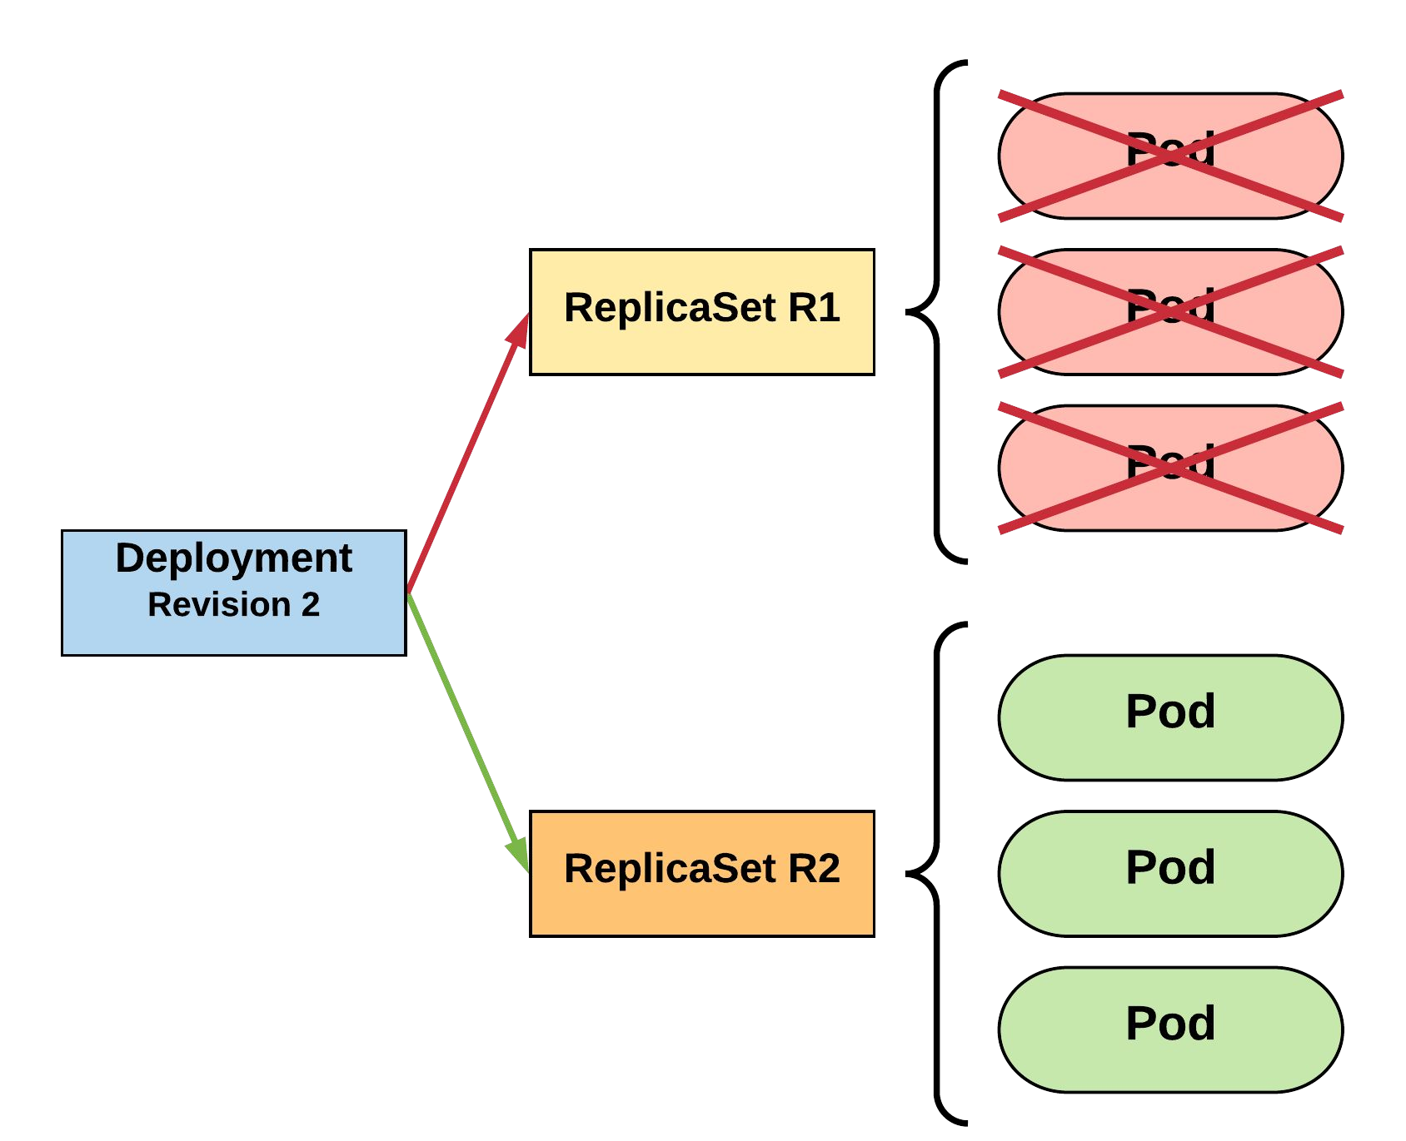
RollingUpdate Deployment
Phase out of old Pods managed by
maxSurge and maxUnavailable.
R1 pod-template-hash: 676677fff
R2 pod-template-hash: 54f7ff7d6d
$ kubectl get replicaset NAME DESIRED | CURRENT | READY | AGE
mydep-54f7ff7d6d 3 | 3 | 3 | 13s
mydep-6766777fff 0 | 0 | 0 | 5h
$ kubectl get pods NAME READY | STATUS | RESTARTS | AGE
mydep-54f7ff7d6d-9gvll 1/1 | Running | 0 | 10s
mydep-54f7ff7d6d-cqvlq 1/1 | Running | 0 | 8s
mydep-54f7ff7d6d-gccr6 1/1 | Running | 0 | 5s

Slide 49
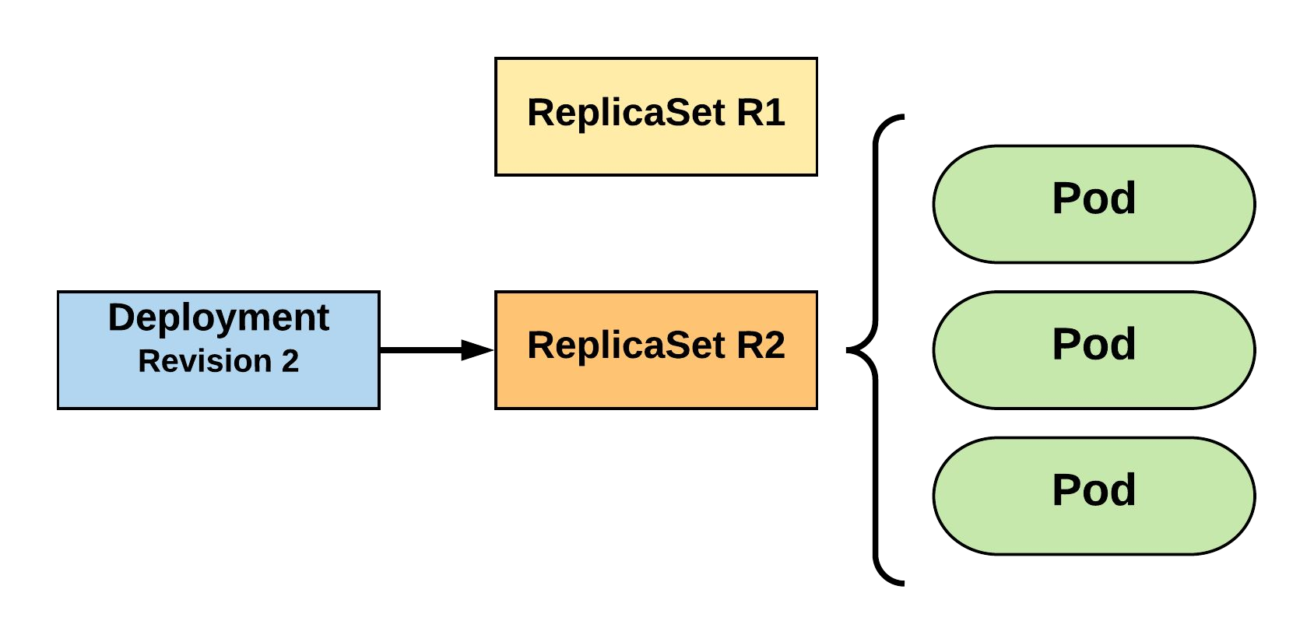
RollingUpdate Deployment
Updated to new deployment revision completed.
R1 pod-template-hash: 676677fff
R2 pod-template-hash: 54f7ff7d6d
$ kubectl get replicaset NAME DESIRED | CURRENT | READY | AGE
mydep-54f7ff7d6d 3 | 3 | 3 | 15s
mydep-6766777fff 0 | 0 | 0 | 5h
$ kubectl get pods NAME READY | STATUS | RESTARTS | AGE
mydep-54f7ff7d6d-9gvll 1/1 | Running | 0 | 12s
mydep-54f7ff7d6d-cqvlq 1/1 | Running | 0 | 10s
mydep-54f7ff7d6d-gccr6 1/1 | Running | 0 | 7s

Slide 50
Volumes
Persistent Volumes
Persistent Volume Claims
StorageClass
Storage
Concepts and Resources

Slide 51
Storage
Pods by themselves are useful, but many workloads require exchanging data between containers, or persisting some form of data.
For this we have Volumes, PersistentVolumes, PersistentVolumeClaims, and StorageClasses.

Slide 52
Volumes
Storage that is tied to the Pod’s Lifecycle.
A pod can have one or more types of volumes attached to it.
Can be consumed by any of the containers within the pod.
Survive Pod restarts; however their durability beyond that is dependent on the Volume Type.

Slide 53
Volume Types
awsElasticBlockStore
azureDisk
azureFile
cephfs
configMap
csi
downwardAPI
emptyDir
fc (fibre channel)
flexVolume
flocker
gcePersistentDisk
gitRepo
glusterfs
hostPath
iscsi
local
nfs
persistentVolumeClaim
projected
portworxVolume
quobyte
rbd
scaleIO
secret
storageos
vsphereVolume
Persistent Volume Supported

Slide 54
Volumes
volumes: A list of volume objects to be attached to the Pod. Every object within the list must have it’s own unique name.
volumeMounts: A container specific list referencing the Pod volumes by name, along with their desired mountPath.
apiVersion: v1 kind: Pod metadata:
name: volume-example spec:
containers:
name: nginx
image: nginx:stable-alpine volumeMounts:
name: html
mountPath: /usr/share/nginx/html ReadOnly: true
name: content
image: alpine:latest command: ["/bin/sh", "-c"] args:
- while true; do
date >> /html/index.html; sleep 5;
done volumeMounts:
name: html mountPath: /html
volumes:
name: html emptyDir: {}

Slide 55
Volumes
volumes: A list of volume objects to be attached to the Pod. Every object within the list must have it’s own unique name.
apiVersion: v1 kind: Pod metadata:
name: volume-example spec:
containers:
name: nginx
image: nginx:stable-alpine volumeMounts:
name: html
mountPath: /usr/share/nginx/html ReadOnly: true
name: content
image: alpine:latest command: ["/bin/sh", "-c"] args:
- while true; do
date >> /html/index.html; sleep 5;
done volumeMounts:
name: html mountPath: /html
volumeMounts: A container specific list referencing the Pod volumes by name, along with their desired mountPath.
volumes:
- name: html emptyDir: {}

Slide 56
Volumes
volumes: A list of volume objects to be attached to the Pod. Every object within the list must have it’s own unique name.
apiVersion: v1 kind: Pod metadata:
name: volume-example spec:
containers:
name: nginx
image: nginx:stable-alpine volumeMounts:
- name: html
mountPath: /usr/share/nginx/html ReadOnly: true
name: content
image: alpine:latest command: ["/bin/sh", "-c"] args:
- while true; do
date >> /html/index.html; sleep 5;
done
volumes:
name: html emptyDir: {}
volumeMounts: A container specific list referencing the Pod volumes by name, along with their desired mountPath.
volumeMounts:
- name: html mountPath: /html

Slide 57
Persistent Volumes
A PersistentVolume (PV) represents a storage resource.
PVs are a cluster wide resource linked to a backing storage provider: NFS, GCEPersistentDisk, RBD etc.
Generally provisioned by an administrator.
Their lifecycle is handled independently from a pod
CANNOT be attached to a Pod directly. Relies on a
PersistentVolumeClaim

Slide 58
PersistentVolumeClaims
A PersistentVolumeClaim (PVC) is a namespaced
request for storage.
Satisfies a set of requirements instead of mapping to a storage resource directly.
Ensures that an application’s ‘claim’ for storage is portable across numerous backends or providers.

Slide 59
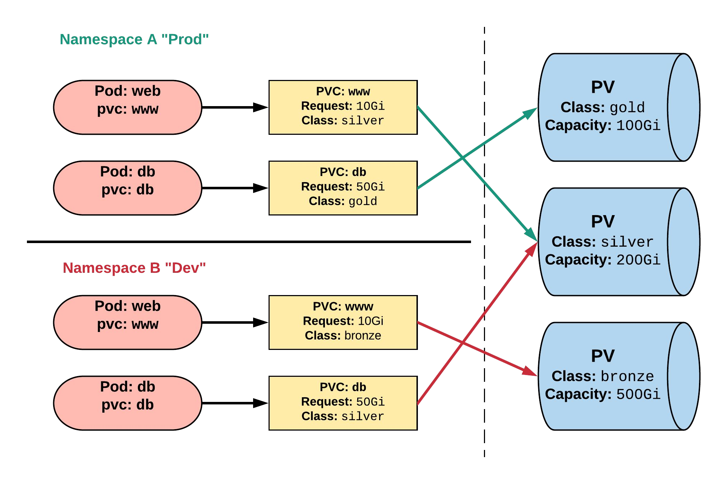
Persistent Volumes and Claims
Cluster Users
Cluster Admins

Slide 60
PersistentVolume
capacity.storage: The total amount of available storage.
volumeMode: The type of volume, this can be either Filesystem or Block.
accessModes: A list of the supported methods of accessing the volume. Options include:
ReadWriteOnce
ReadOnlyMany
ReadWriteMany
apiVersion: v1
kind: PersistentVolume metadata:
name: nfsserver spec:
capacity: storage: 50Gi
volumeMode: Filesystem accessModes:
ReadWriteOnce
ReadWriteMany persistentVolumeReclaimPolicy: Delete storageClassName: slow
mountOptions:
hard
nfsvers=4.1 nfs:
path: /exports server: 172.22.0.42

Slide 61
PersistentVolume
persistentVolumeReclaimPolicy: The behaviour for PVC’s that have been deleted. Options include:
Retain - manual clean-up
Delete - storage asset deleted by provider.
storageClassName: Optional name of the storage class that PVC’s can reference. If provided, ONLY PVC’s referencing the name consume use it.
mountOptions: Optional mount options for the PV.
apiVersion: v1
kind: PersistentVolume metadata:
name: nfsserver spec:
capacity: storage: 50Gi
volumeMode: Filesystem accessModes:
ReadWriteOnce
ReadWriteMany persistentVolumeReclaimPolicy: Delete storageClassName: slow
mountOptions:
hard
nfsvers=4.1 nfs:
path: /exports server: 172.22.0.42

Slide 62
PersistentVolumeClaim
accessModes: The selected method of accessing the storage. This MUST be a subset of what is defined on the target PV or Storage Class.
ReadWriteOnce
ReadOnlyMany
ReadWriteMany
resources.requests.storage: The desired amount of storage for the claim
storageClassName: The name of the desired Storage Class
kind: PersistentVolumeClaim apiVersion: v1
metadata:
name: pvc-sc-example spec:
accessModes:
- ReadWriteOnce resources:
requests: storage: 1Gi
storageClassName: slow

Slide 63
PVs and PVCs with Selectors
kind: PersistentVolume apiVersion: v1 metadata:
name: pv-selector-example labels:
type: hostpath spec:
capacity: storage: 2Gi
accessModes:
- ReadWriteMany hostPath:
path: "/mnt/data"
kind: PersistentVolumeClaim apiVersion: v1
metadata:
name: pvc-selector-example spec:
accessModes:
- ReadWriteMany resources:
requests: storage: 1Gi
selector: matchLabels:
type: hostpath

Slide 64
PVs and PVCs with Selectors
kind: PersistentVolume apiVersion: v1 metadata:
name: pv-selector-example labels:
type: hostpath spec:
capacity: storage: 2Gi
accessModes:
- ReadWriteMany hostPath:
path: "/mnt/data"
kind: PersistentVolumeClaim apiVersion: v1
metadata:
name: pvc-selector-example spec:
accessModes:
- ReadWriteMany resources:
requests: storage: 1Gi
selector:
matchLabels: type: hostpath

Slide 65
PV Phases
Available
PV is ready and available to be consumed.
Bound
The PV has been bound to a claim.
Released
The binding PVC has been deleted, and the PV is pending reclamation.
Failed
An error has been encountered attempting to reclaim the PV.

Slide 66
StorageClass
Storage classes are an abstraction on top of an external storage resource (PV)
Work hand-in-hand with the external storage system to enable dynamic provisioning of storage
Eliminates the need for the cluster admin to pre-provision a PV

Slide 67
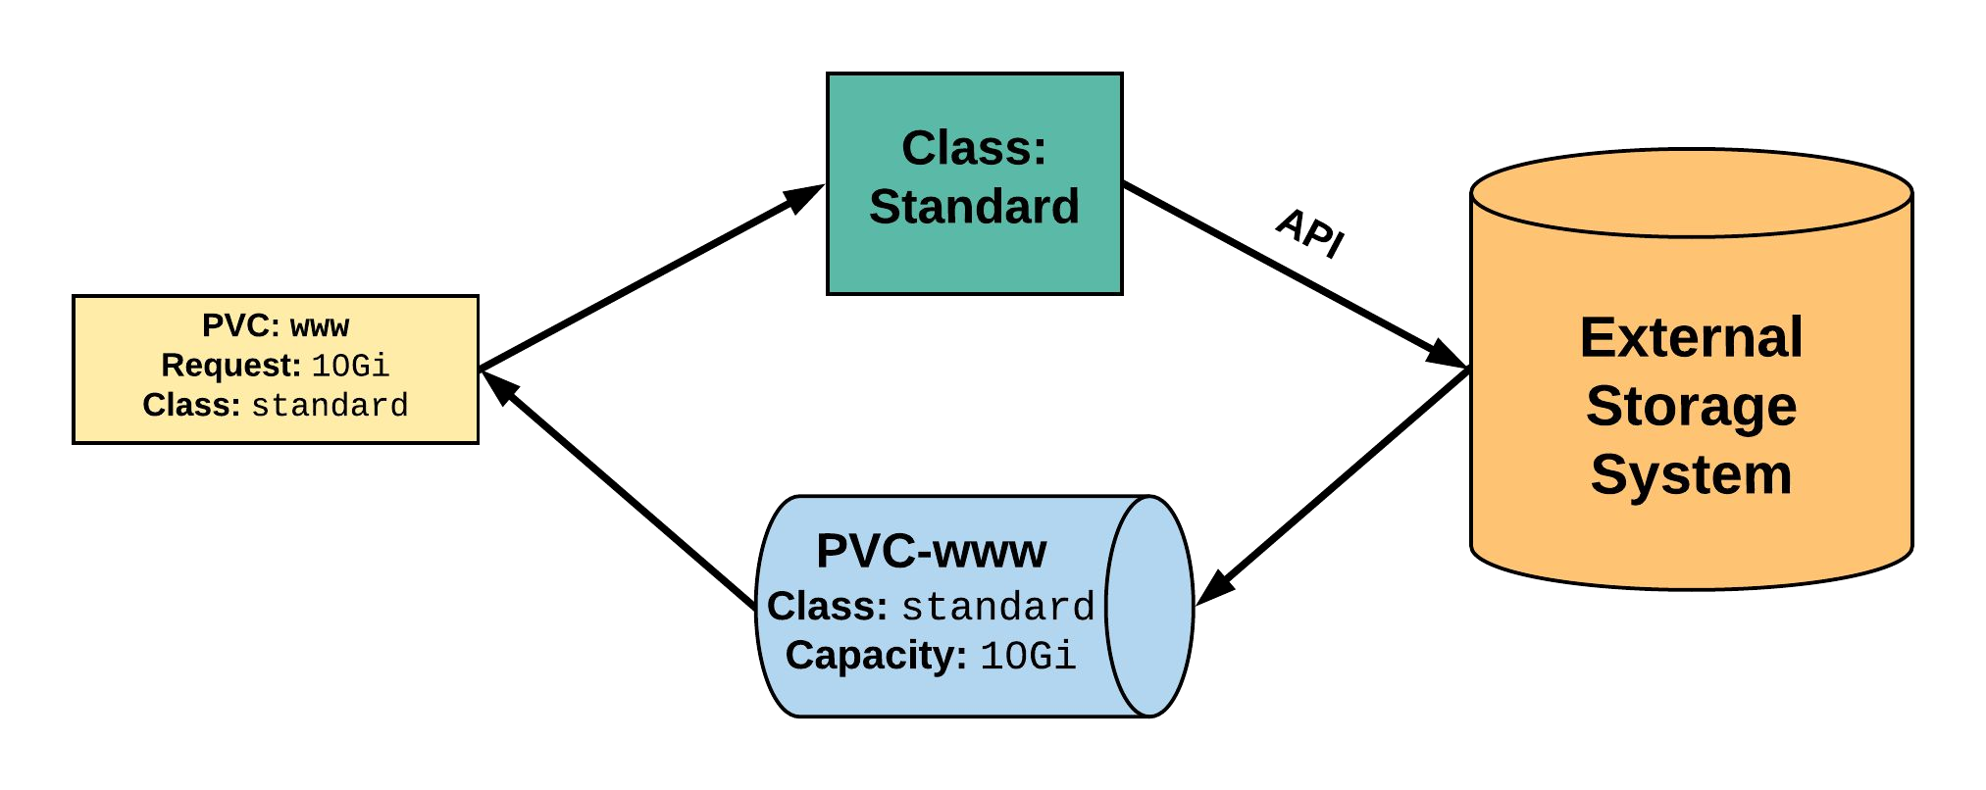
StorageClass
2. StorageClass provisions request through API with
1. PVC makes a request of ^{external storage system.} the StorageClass.
uid: 9df65c6e-1a69-11e8-ae10-080027a3682b
4. provisioned PV is bound to requesting PVC.
3. External storage system creates a PV strictly satisfying the PVC request.
pv: pvc-9df65c6e-1a69-11e8-ae10-080027a3682b

Slide 68
StorageClass
provisioner: Defines the ‘driver’ to be used for provisioning of the external storage.
parameters: A hash of the various configuration parameters for the provisioner.
reclaimPolicy: The behaviour for the backing storage when the PVC is deleted.
Retain - manual clean-up
Delete - storage asset deleted by provider
kind: StorageClass apiVersion: storage.k8s.io/v1 metadata:
name: standard
provisioner: kubernetes.io/gce-pd parameters:
type: pd-standard
zones: us-central1-a, us-central1-b reclaimPolicy: Delete

Slide 69
Available StorageClasses
AWSElasticBlockStore
AzureFile
AzureDisk
CephFS
Cinder
FC
FlexVolume
Flocker
GCEPersistentDisk
Glusterfs
Internal Provisioner
iSCSI
PhotonPersistentDisk
Quobyte
NFS
RBD
VsphereVolume
PortworxVolume
ScaleIO
StorageOS
Local

Slide 70
Lab - github.com/mrbobbytables/k8s-intro-tutorials/blob/master/storage
Working with Volumes

Slide 71
Configuration
ConfigMap
Secret
Concepts and Resources

Slide 72
Configuration
Kubernetes has an integrated pattern for decoupling configuration from application or container.
This pattern makes use of two Kubernetes components: ConfigMaps and Secrets.

Slide 73
ConfigMap
Externalized data stored within kubernetes.
Can be referenced through several different means:
environment variable
a command line argument (via env var)
injected as a file into a volume mount
Can be created from a manifest, literals, directories, or files directly.

Slide 74
ConfigMap
apiVersion: v1 kind: ConfigMap metadata:
name: manifest-example data:
state: Michigan city: Ann Arbor content: |
Look at this, its multiline!
data: Contains key-value pairs of ConfigMap contents.

Slide 75
ConfigMap Example
All produce a ConfigMap with the same content!
apiVersion: v1 kind: ConfigMap metadata:
name: manifest-example data:
city: Ann Arbor state: Michigan
$ kubectl create configmap literal-example \
--from-literal="city=Ann Arbor" --from-literal=state=Michigan
configmap “literal-example” created
$ cat info/city Ann Arbor
$ cat info/state Michigan
$ kubectl create configmap dir-example --from-file=cm/
configmap "dir-example" created
$ cat info/city Ann Arbor
$ cat info/state Michigan
$ kubectl create configmap file-example --from-file=cm/city --from-file=cm/state
configmap "file-example" created

Slide 76
ConfigMap Example
All produce a ConfigMap with the same content!
apiVersion: v1 kind: ConfigMap metadata:
name: manifest-example data:
city: Ann Arbor state: Michigan
$ kubectl create configmap literal-example \
--from-literal="city=Ann Arbor" --from-literal=state=Michigan
configmap “literal-example” created
$ cat info/city Ann Arbor
$ cat info/state Michigan
$ kubectl create configmap dir-example --from-file=cm/
configmap "dir-example" created
$ cat info/city Ann Arbor
$ cat info/state Michigan
$ kubectl create configmap file-example --from-file=cm/city --from-file=cm/state
configmap "file-example" created

Slide 77
ConfigMap Example
All produce a ConfigMap with the same content!
apiVersion: v1 kind: ConfigMap metadata:
name: manifest-example data:
city: Ann Arbor state: Michigan
$ kubectl create configmap literal-example \
--from-literal="city=Ann Arbor" --from-literal=state=Michigan
configmap “literal-example” created
$ cat info/city Ann Arbor
$ cat info/state Michigan
$ kubectl create configmap dir-example configmap "dir-example" created
--from-file=cm/
$ cat info/city Ann Arbor
$ cat info/state Michigan
$ kubectl create configmap file-example --from-file=cm/city --from-file=cm/state
configmap "file-example" created

Slide 78
ConfigMap Example
All produce a ConfigMap with the same content!
apiVersion: v1 kind: ConfigMap metadata:
name: manifest-example data:
city: Ann Arbor state: Michigan
$ kubectl create configmap literal-example \
--from-literal="city=Ann Arbor" --from-literal=state=Michigan
configmap “literal-example” created
$ cat info/city Ann Arbor
$ cat info/state Michigan
$ kubectl create configmap dir-example --from-file=cm/
configmap "dir-example" created
$ cat info/city Ann Arbor
$ cat info/state Michigan
$ kubectl create configmap file-example configmap "file-example" created
--from-file=cm/city --from-file=cm/state

Slide 79
Secret
Functionally identical to a ConfigMap.
Stored as base64 encoded content.
Encrypted at rest within etcd (if configured!).
Ideal for username/passwords, certificates or other sensitive information that should not be stored in a container.
Can be created from a manifest, literals, directories, or from files directly.

Slide 80
Secret
apiVersion: v1 kind: Secret metadata:
name: manifest-secret type: Opaque
data:
username: ZXhhbXBsZQ== password: bXlwYXNzd29yZA==
type: There are three different types of secrets within Kubernetes:
docker-registry - credentials used to authenticate to a container registry
generic/Opaque - literal values from different sources
tls - a certificate based secret
data: Contains key-value pairs of base64 encoded content.

Slide 81
Secret Example
All produce a Secret with the same content!
apiVersion: v1 kind: Secret metadata:
name: manifest-example type: Opaque
data:
username: ZXhhbXBsZQ== password: bXlwYXNzd29yZA==
$ kubectl create secret generic literal-secret \
--from-literal=username=example \
--from-literal=password=mypassword
secret "literal-secret" created
$ cat info/username example
$ cat info/password mypassword
$ kubectl create secret generic dir-secret --from-file=secret/ Secret "file-secret" created
$ cat secret/username example
$ cat secret/password mypassword
$ kubectl create secret generic file-secret --from-file=secret/username --from-file=secret/password
Secret "file-secret" created

Slide 82
Secret Example
All produce a Secret with the same content!
apiVersion: v1 kind: Secret metadata:
name: manifest-example type: Opaque
data:
username: ZXhhbXBsZQ== password: bXlwYXNzd29yZA==
$ kubectl create secret generic literal-secret \
>
>
secret "literal-secret" created
--from-literal=username=example \
--from-literal=password=mypassword
$ cat info/username example
$ cat info/password mypassword
$ kubectl create secret generic dir-secret --from-file=secret/ Secret "file-secret" created
$ cat secret/username example
$ cat secret/password mypassword
$ kubectl create secret generic file-secret --from-file=secret/username --from-file=secret/password
Secret "file-secret" created

